Slide 1

TECHNODIVERSITY
PR1 FACTS & METHODS
TDiv PR1-C03-Figures
Jörn Erler, Technische Universität Dresden (conception, design and original writing);
Raffaele Spinelli, Consiglio Nazionale delle Ricerche Firence (revision, analysis and co-writing)

Slide 2
net income
€/m³
price
€/ m³
harvesting cost; €/ m³
costs step 1
€/ m³
costs step 2
€/ m³
productive work; €/ m³
additional work; €/ m³
costs per PMH₁₅; €/h
performance per PMH₁₅; m³/h
additional cost; €
total per-formance; m³

Slide 3
m³ per hour
time per m³
Volume (m³/tree)

Slide 4
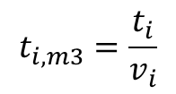

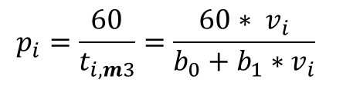
$$t_{i,m3}=\frac{t_{i}}{v_{i}}$$
$$t_{i}=b_{0}+b_{1}∗v_{i}$$
$$p_{i}=\frac{60}{t_{i,m3}}=\frac{60∗ v_{i}}{b_{0}+b_{1}∗v_{i}}$$

Slide 5
m³ per hour
time per m³
b₁
b₀
Volume (m³/tree)
1

Slide 7
Motor-manual work
b₀ = 8,5
b₁ = 27,0
Mechanized work
b₀ = 0,8
b₁ = 2,0
min/tree
min/m³
m³/h
min/tree
m³/h
min/m³
Vol per tree
Vol per tree

Slide 8
Costs per m³

Slide 9
M_10-23
Harvester

