Slide 1

TECHNODIVERSITY
PR1 FACTS & METHODS
TDiv PR1-B03 Figures
Jörn Erler, Technische Universität Dresden (conception, design and original writing);
Raffaele Spinelli, Consiglio Nazionale delle Ricerche Firence (revision, analysis and co-writing)

Slide 2
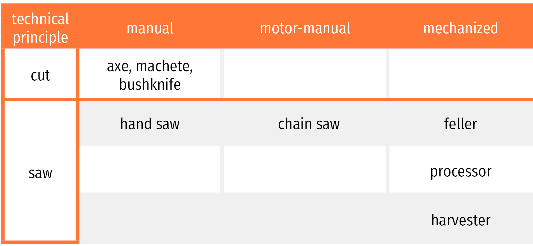

Slide 3
complete tree
fell
full tree
feller
delimb
object state change
tree length
crosscut
log
processor
harvester
chip
chips

Slide 4
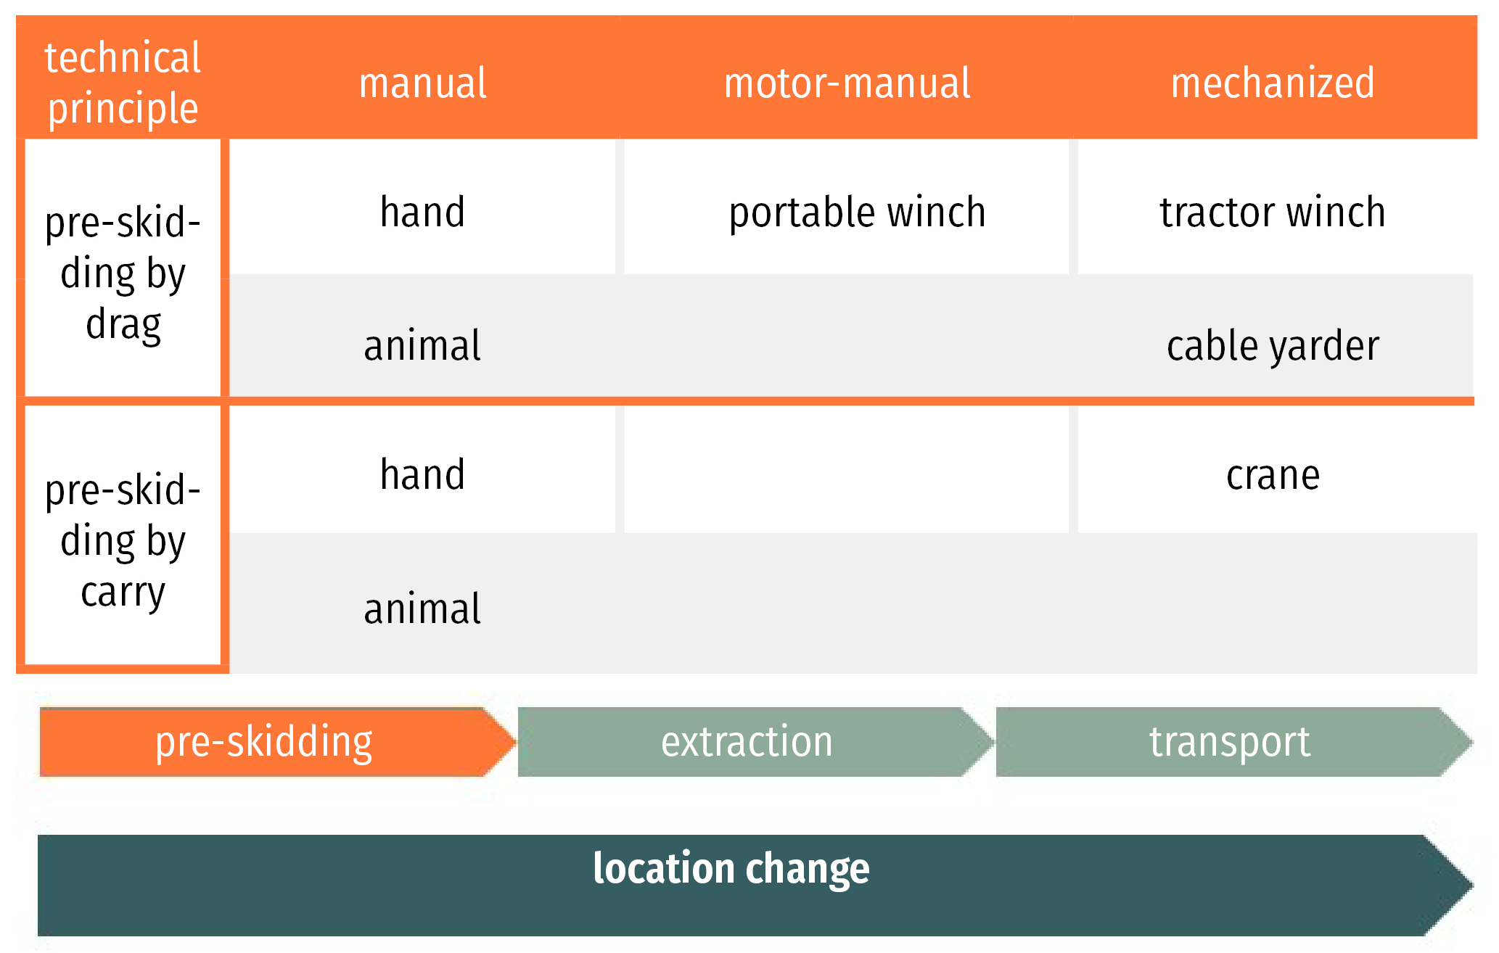

Slide 6
