Slide 1
TECHNODIVERSITY
PR1 FACTS & METHODS
TDiv PR1-D03-Figures
Jörn Erler, Technische Universität Dresden (conception, design and original writing);
Raffaele Spinelli, Consiglio Nazionale delle Ricerche Firence (revision, analysis and co-writing)

Slide 2
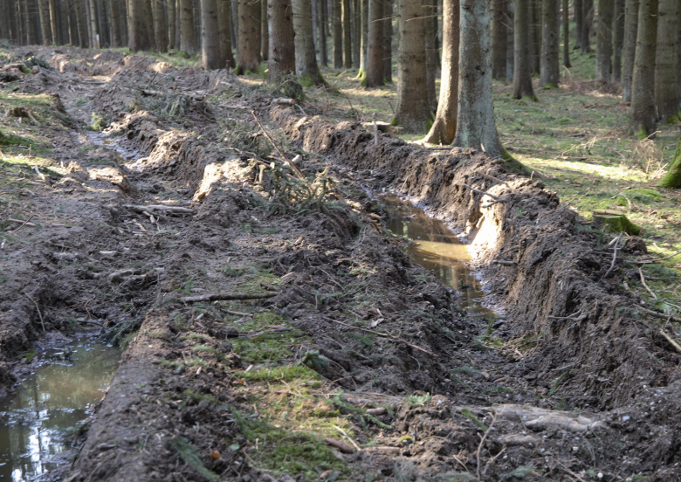
biological active forest soil
accessible trails
destroyed trails

Slide 3
type 1
organic top layer (O)
mineral top layer (A)
mineral subsoil (B, C)
type 2
ridges on side, given by extrusion and lifting of soil
type 3
ridges on side, coming from floating soil

Slide 4
type 1
organic top layer (O)
mineral top layer (A)
mineral subsoil (B, C)
ridges on side, given by extrusion and lifting of soil
type 2
ridges on side, coming from floating soil
type 3

Slide 5
type 1
type 2
type 3
passage without risk
risk analysis
deep ruts
test passage
no ridges on sides
ruts < 10 cm
ridges on sides
ruts ≥ 10 cm
reduce ground pressure
passage allowed
no passage

